Slide 1
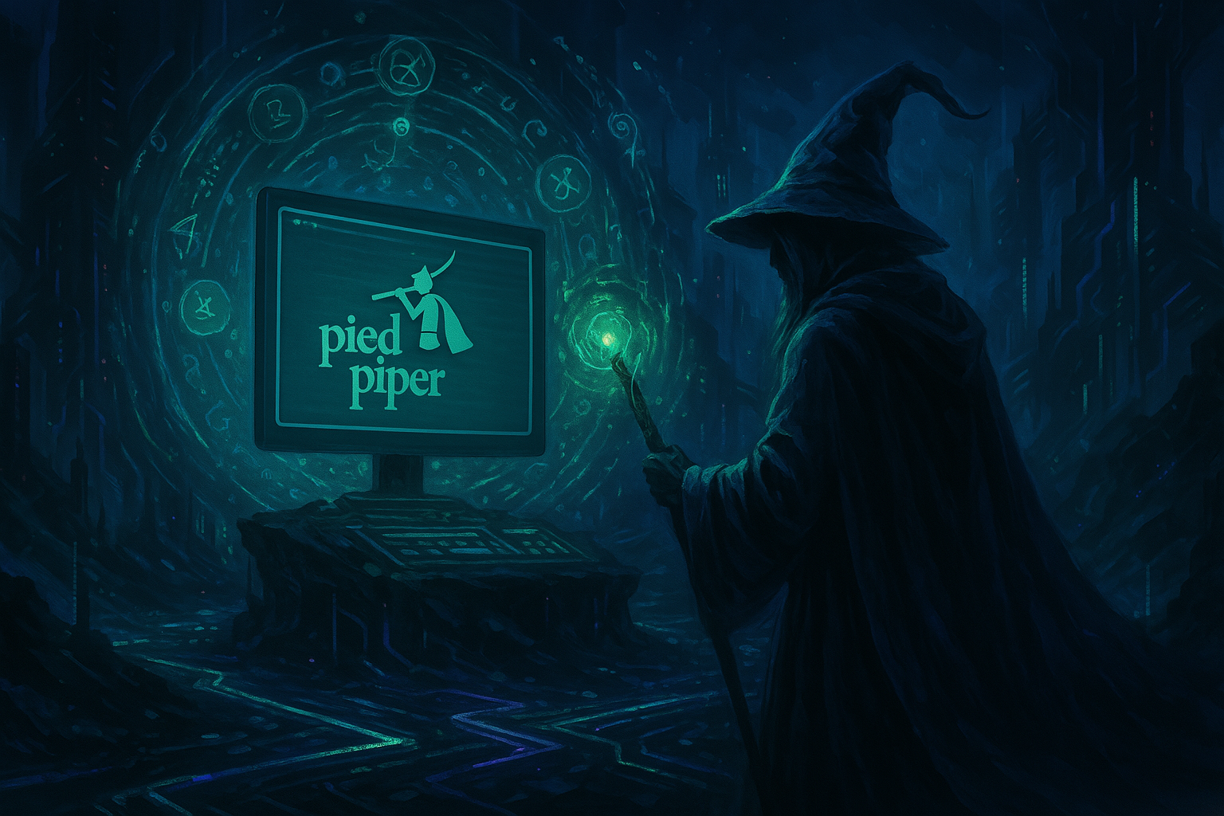

Here begins the tale of
Pied Piper. THE WIZARD.
Let this scroll be opened,
Let the words take shape,
Let the commands awaken.

Slide 2



🧝‍♂️ Who is the Pied Piper?
You’ve heard of the Pied Piper —
a mysterious figure who led the way with music,
charming crowds, guiding the lost,
and controlling the chaos with nothing but a melody.
We are that team.
But instead of a flute, we play the terminal.
And instead of music — we speak commands.
Introducing our creation:
COMMANDUS — the digital wizard of order.
We are Pied Piper.
We are the ones who tame the chaos of the terminal.
And this is our magic.

Slide 3
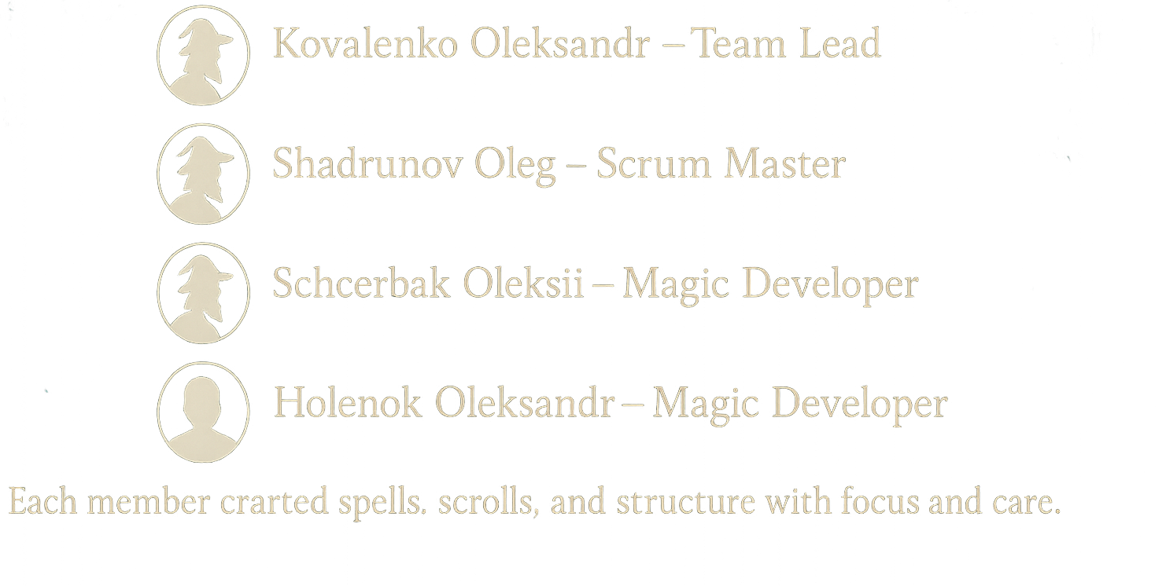
The Fellowship of the Bot
Behind every great wizard, there is a greater team.
Here’s ours:

Slide 4
Welcome to the Realm
of Commandus
the Wizard
In a world full of forgotten birthdays, lost phone numbers, and scattered notes…
rises a wizard of the terminal.
His name is Commandus.
With a flick of a keyboard and a whisper of a command,
he brings order to your digital chaos.
A realm where magic is spoken through commands.

Slide 5
Our Quest (Project Idea)
To build a console-based wizard-assistant who can:
- Manage contacts and store everything from names to birthdays
- Keep your thoughts safe in well-tagged magical notes
- Foresee upcoming events and remind you in time
- Powerful search in notes by tags and words and
in contacts by each fild.
Our mission: to awaken a helper that listens and understands.

Slide 6




The Wizard’s Arsenal
🪄 Language: Python 3
📖 Spellbook: datetime, re, os, sys
🔮 Magic Scrolls: 🥒 pickle, rich
🛠️ Teamwork Portals: GitHub, Slack, Trello.

Slide 7
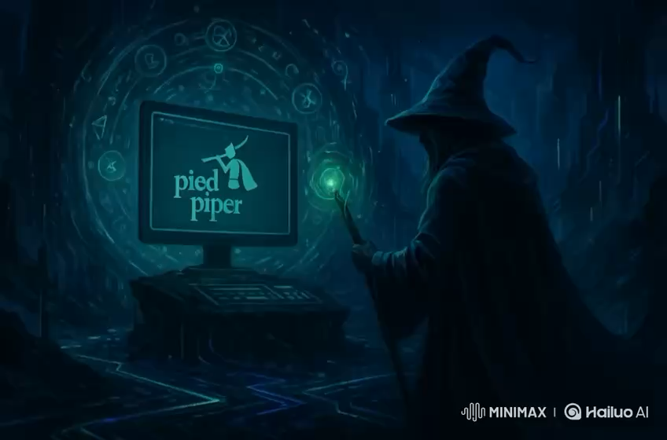
The Live Ritual (Demo)

